Slide 1


PROJECT EVE

Slide 2
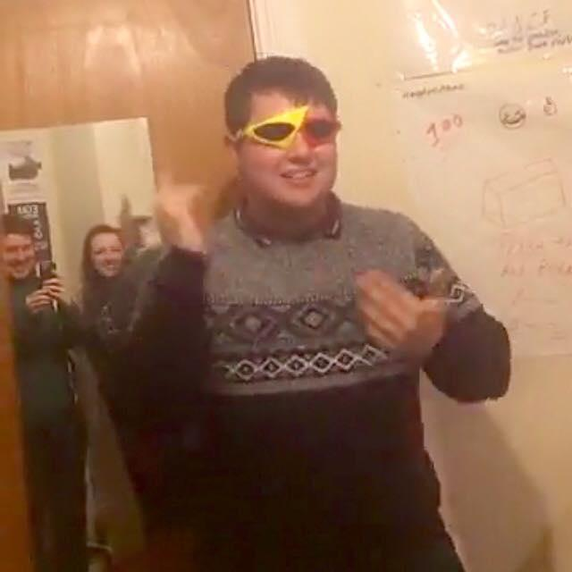
Do they even go here?
Darragh King (Search, Maps and Users)
“I had never worked with Laravel before, this project gave me a chance to learn how to use it, as well as try a bit of everything, for example javascript, APIs etc”
Eimear Crotty (Events, Maps and Ticket Information)
“After spending the Christmas break learning Laravel, I wanted to practice it and find out how a website is completed - from concept to final build.”
Colm Cahalane (Social Media Integration, Stripe, Scanned Tickets and Users)
“I’d tried out Laravel before but wanted to use this project to take on new challenges, dealing with integrations, payments, APIs, and the Knockout.js library.”

Slide 3
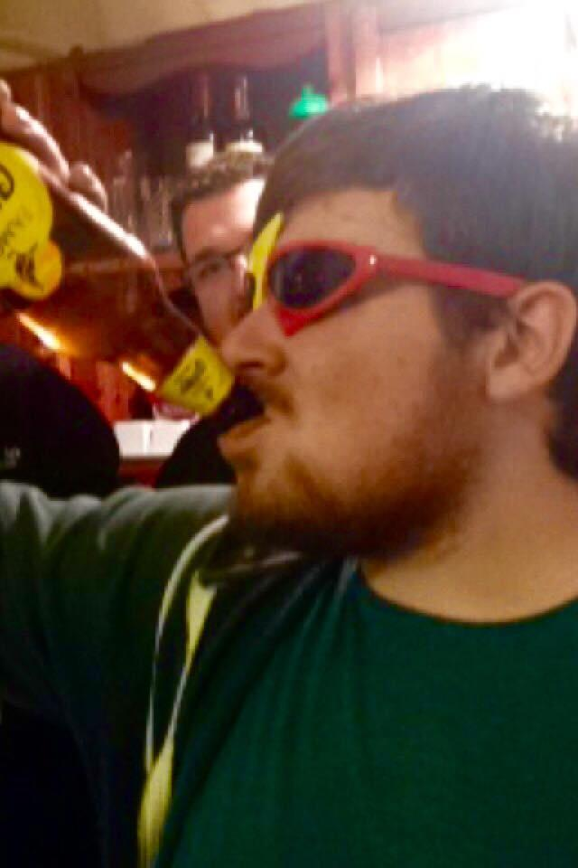
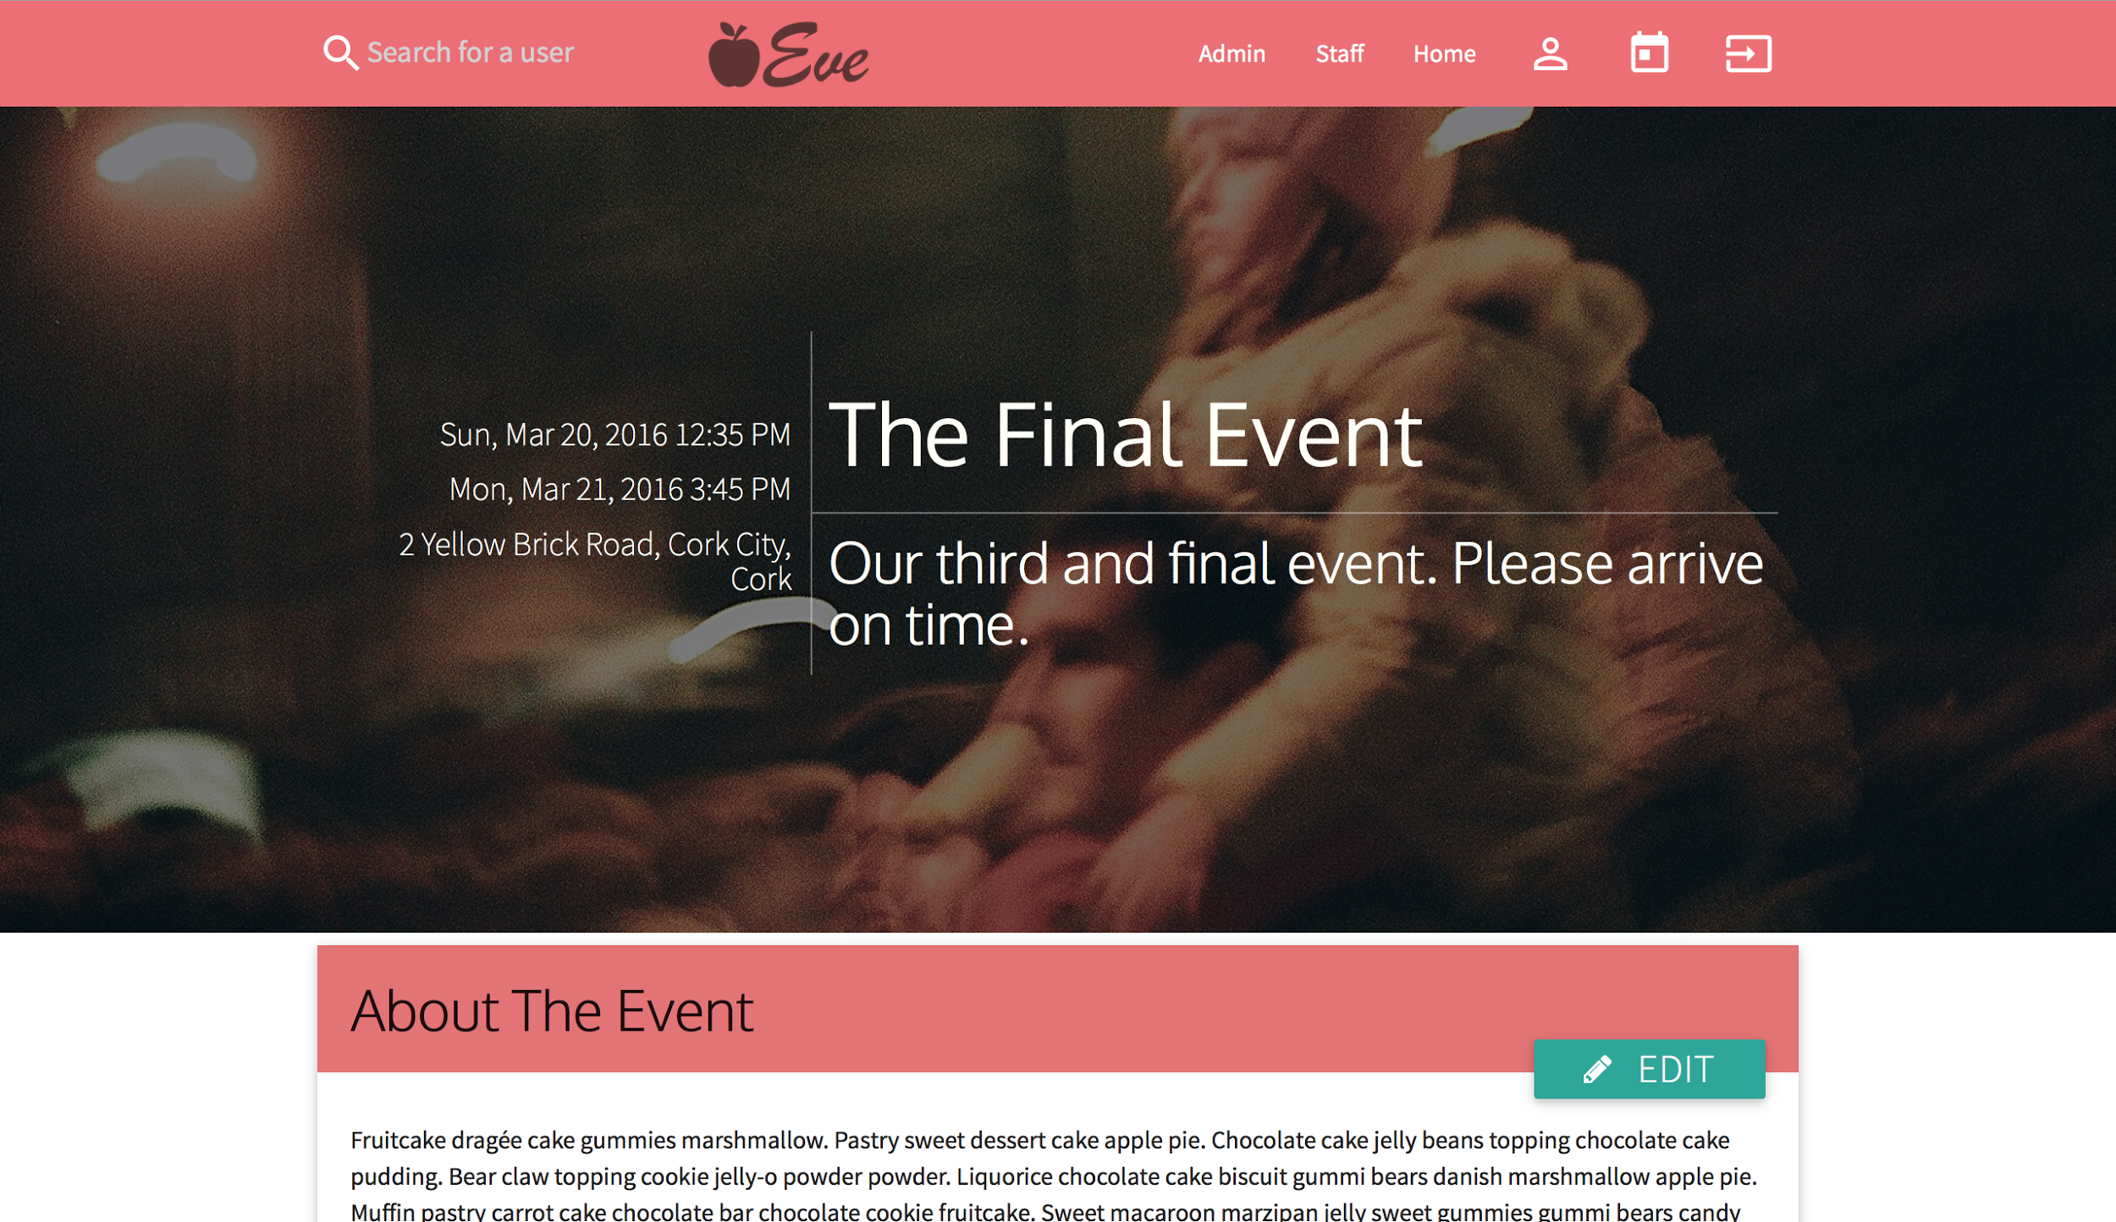
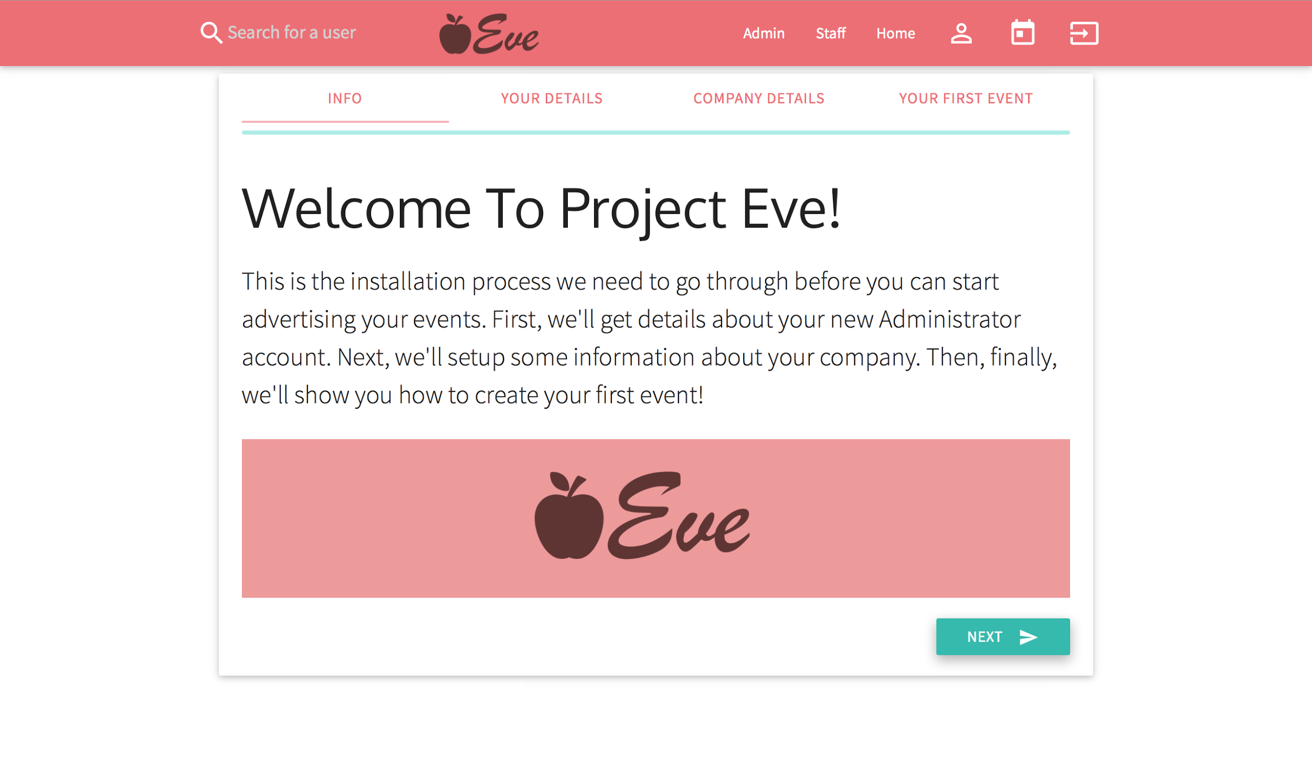
Do they even go here?
Mervyn Galvin (Partners, APIs and Dedicated Testing)
“I’d worked with frameworks before but didn’t have much experience. This project not only gave me that, but teamwork, time-management and collaboration experience too”
Evan Smith (Kanban Master, Admin, Users, Translation and Generalist)
“I’ve always enjoyed making projects for myself and with others. Becoming Kanban Master for the project gave me a new opportunity to help direct people and do things bigger than I could have done alone.”

Slide 4

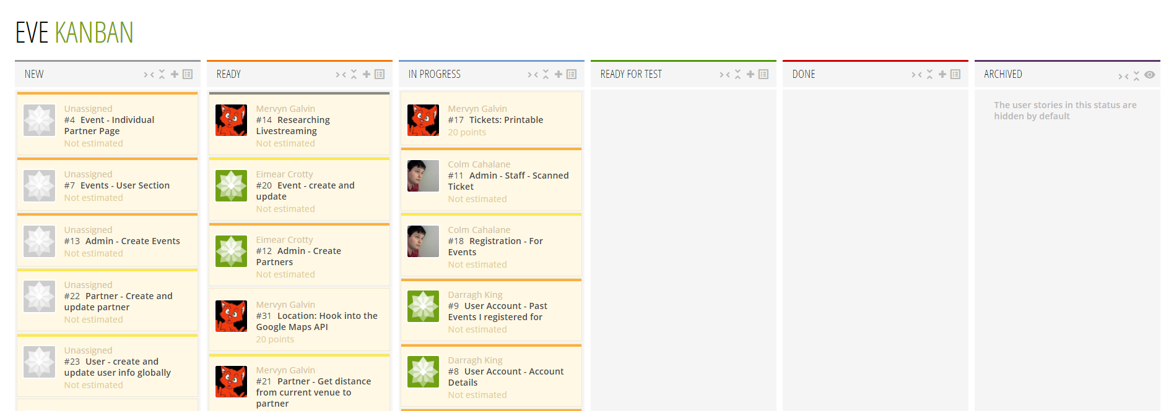
Our Management Approach
Kanban
Evan was our Kanban Sensei (senpai)
Just general guidance and overall task management
Taiga.io as kanban board
Github as source control + code collaboration
Integrates bug tracking and issues with our Taiga board
Google Drive for document and information storage
What Went Wrong?
Life got in the way, a lot of meetings didn’t happen (same with group coding)
Too many 4AM commits and bugs as a result (as well as bug fixes TBF)

Slide 5
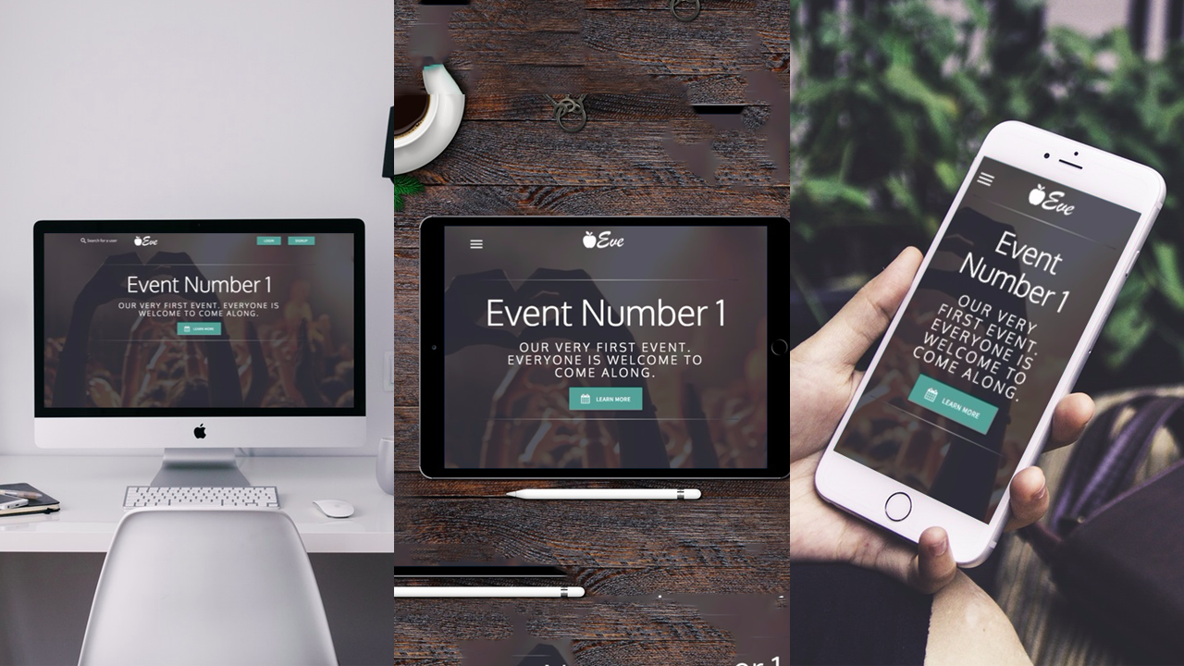

Slide 6

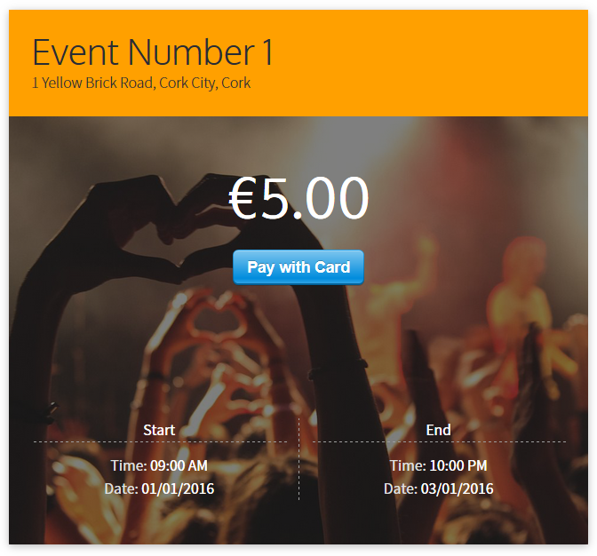
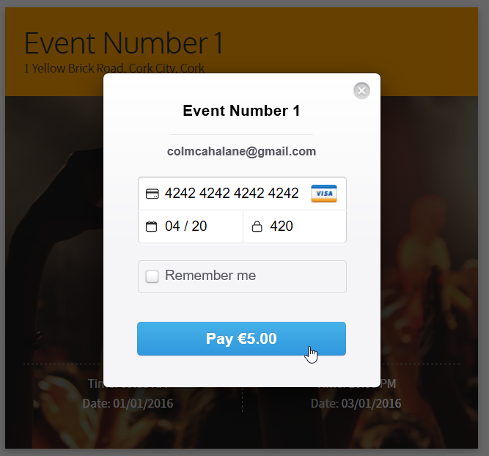
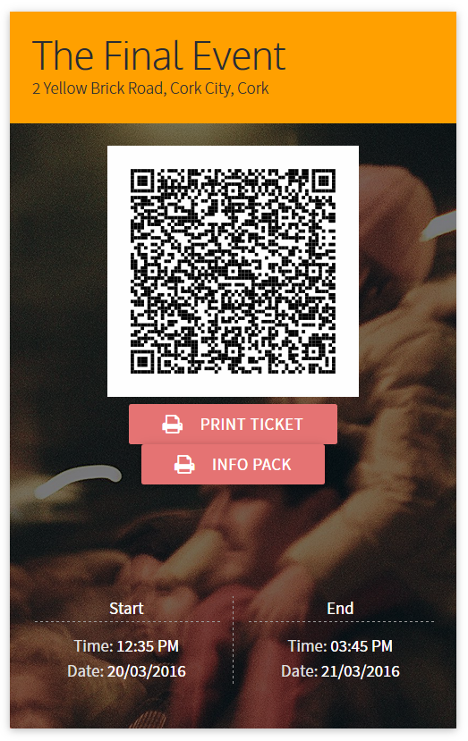
The technical approach
PHP - familiar and allowed us to move fast.
MySQL- if it ain’t broke, don’t fix it.
Laravel - an industry-standard MVC framework
allowed us to conform to standards/best practice
Gulp & LESS to manage and gather CSS & JS
Materialize.css - Lovely CSS framework
Follows Google’s Material Design guidelines
Knockout.js as front-end framework (On some pages only)
.editorconfig - allows us to keep consistent style rules on any preferred editor/IDE
Most of our team used Sublime Text with extensions like Emmet, Autocomplete Anything and PHPLint.
Others used Jetbrains’ PHPStorm for an IDE approach.
Composer Packages like SimpleQR, Stripe, and Translations
Vagrant & VirtualBox - consistent development environment on each developer’s machine
How it feels to code with Laravel
Extensibility through Composer let us easily add features like Stripe payments

Slide 7

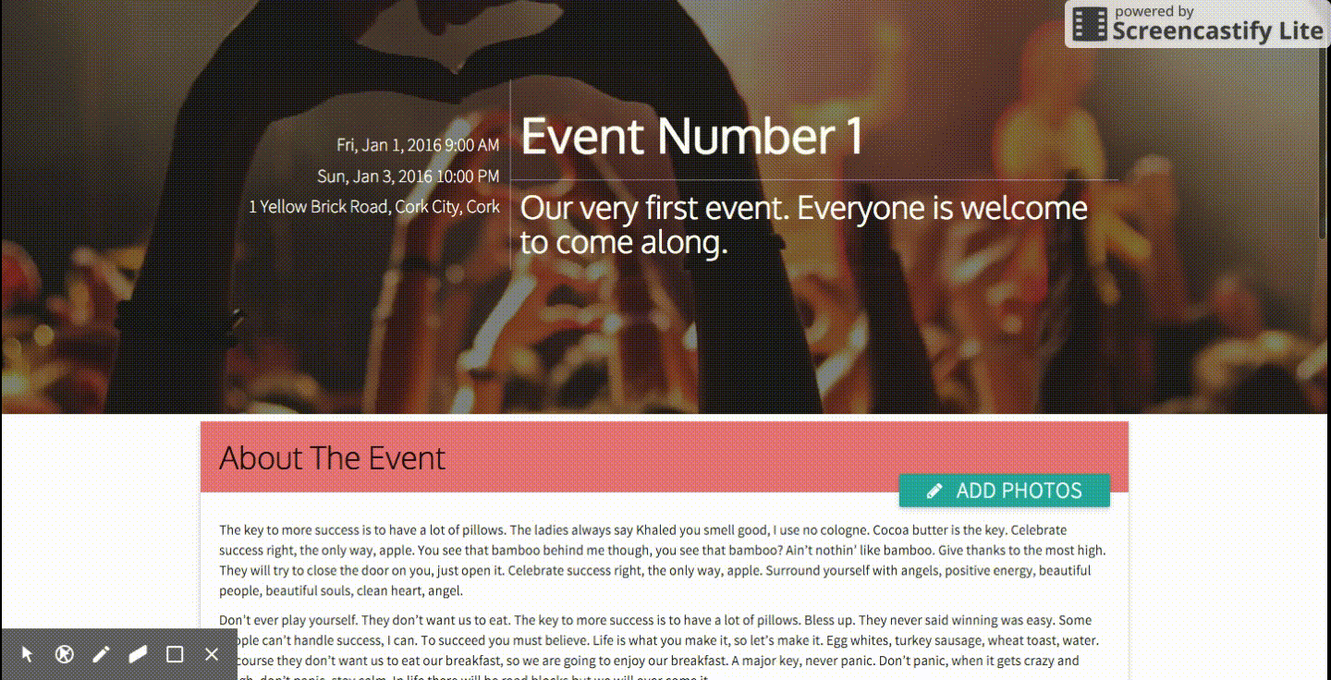
There’s always time for a nice cup of tea
Time Estimates
Split the project into milestones
Estimated length in weeks
Updated as more information was gathered
Allowed us to see which parts of the project spec we could achieve
Our Time
Dedicated the first week solely to planning
We were ahead of all of our estimates
Dedicated extra time to testing + enhancements
Majority of our time was spent coding and researching
actual footage of our kanban sensei

Slide 8
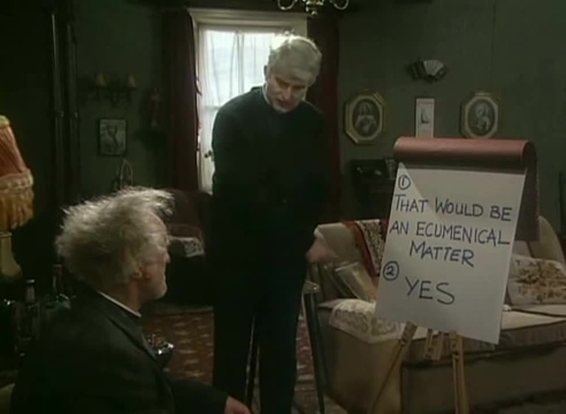
That would be an ecunemenical matter
What We Would Change And Recommend
More structure to group coding
Dedicated room every week
Try find everyone a laptop to work from
Spend 1 week on training and sample code
Centralised documentation/changelog
A communication tool for work rather than using Facebook (maybe Slack?)
Otherwise, we really enjoyed our management style & technical stack and would happily use it on another project!

Slide 9

“Meals are at eleven, one, half-two, three, five, seven, and nine, and if you want a quick snack, you can just ask Mrs. Doyle Evan there.”
Five Milestones To Complete
Minimal Viable Product ✓ Basic working prototype of the main project goals Planned to take: 3 weeks Completed in: 3 weeks
Payments Integration ✓ Implementing Stripe API to allow ticket sales Planned to take: 1 week Completed in: 2 days
Partners V2 ✓ Integration with Google Maps/Places for interactive maps and rich data about partner companies Planned to take: 2 weeks Completed in: 2 weeks
Social Media ✓ Using Facebook to authenticate users and “friend lists” for events Planned to take: 2 weeks Completed in: 2 weeks
Optimisation 🕗 Gathering information to help organisers choose a venue. We knew we couldn’t reach this target in the time given, but left it as a possible extension.

Slide 10
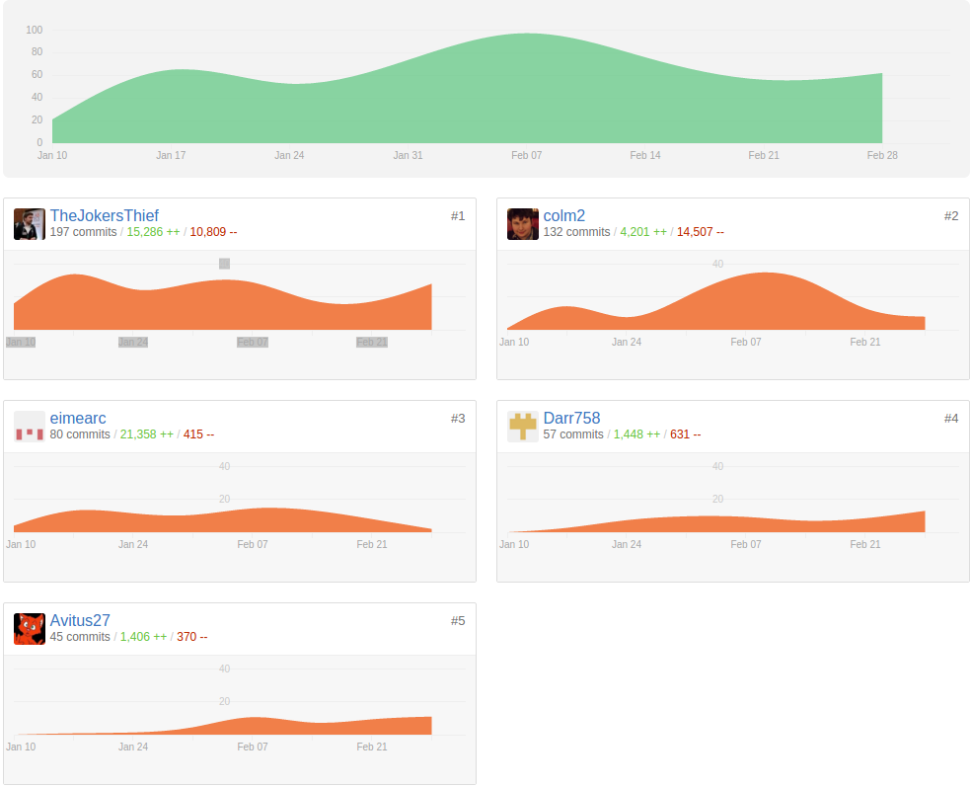
These graphs show commits by different members of the project over time, showing that we kept a steady pace throughout.
We were slow at first as we were in the design stage
We were most active mid-project (Milestones 3 and 4)
We’re trailing off again near the completion stage
Evan added the initial files, that’s why he has so many additions/deletes
Colm deleted a lot of javascript libraries

Slide 11
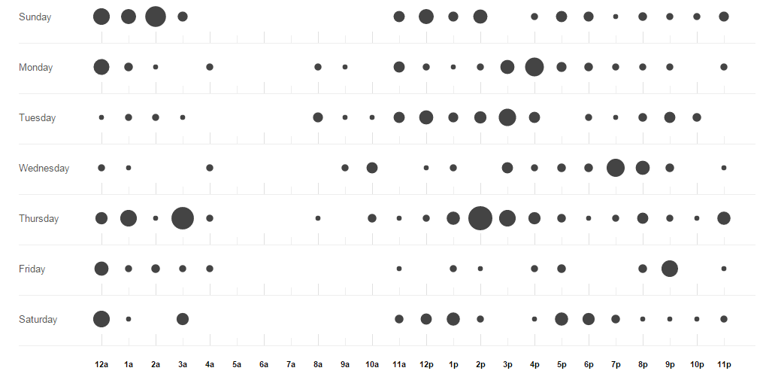
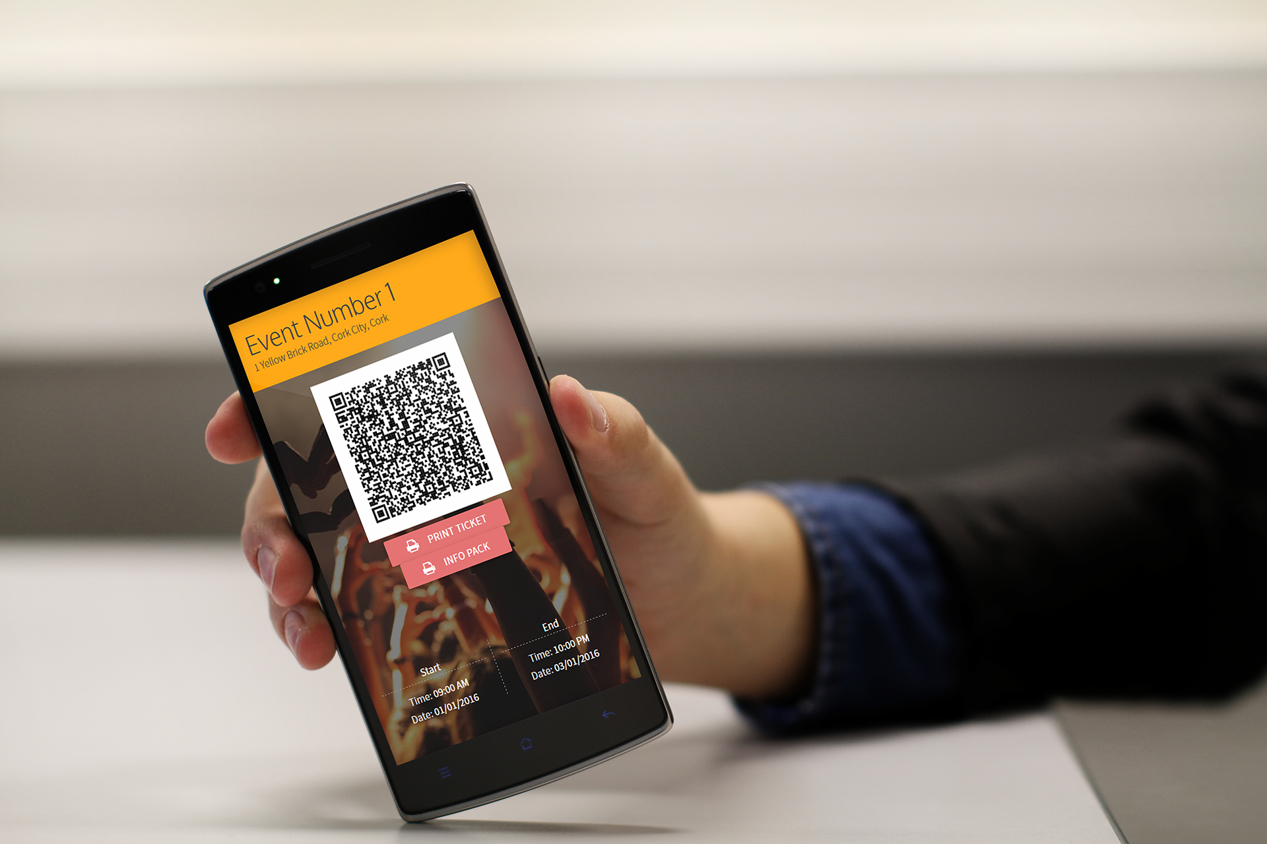
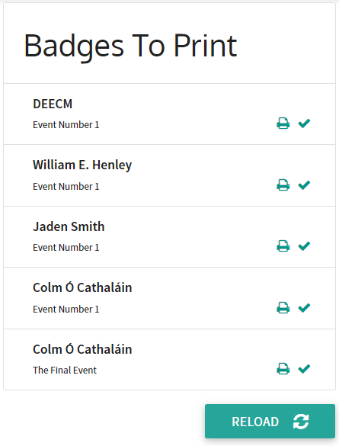
The Punch Card: Activity on different days/hours
Featured feature: ticket scanning and verification
We’re students. We work mostly on weekends, we’re weirdly busy at 3am, and don’t expect us to work before 12 on Sundays.
Our busiest section, 2pm on Thursdays, coincides with our weekly group coding sessions.

Slide 12
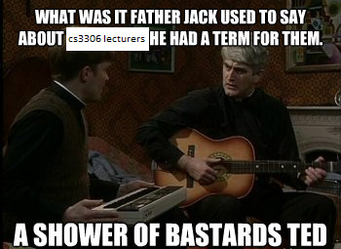
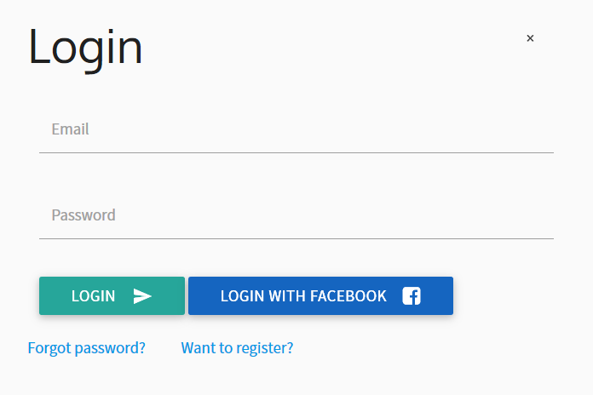
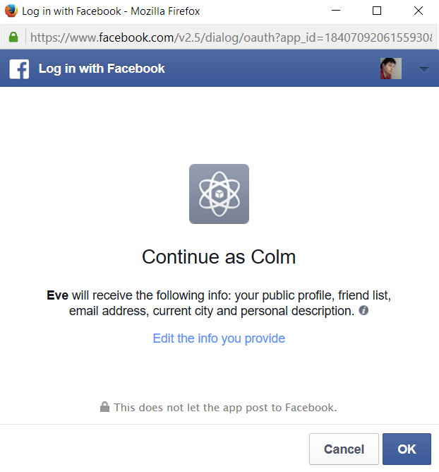
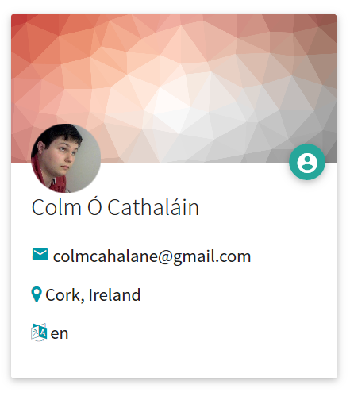
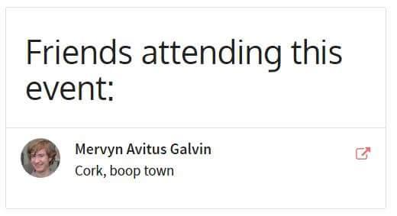
What was out of our control?
TripAdvisor API
Didn’t meet requirements to use it
We didn’t want it anyway
Life
Unexpected challenges, changes and all the rest of it
College tests + surprise lectures
CS3306
Lack of a clear structure and spec
For presentations
For reports
Time to consider
* ten arduous hours of effort in MS Paint

Slide 13
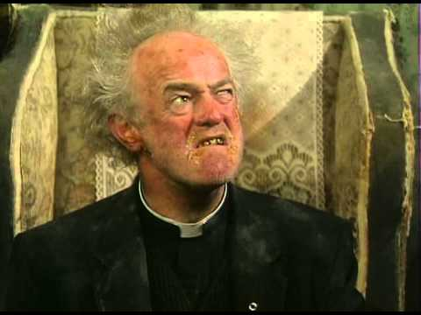

php is a respectable technology used by professionals
please invest one billion dollars in Eve ideas
vote for Eve, we’re not Fine Gael
Eve: Not A Racist

Slide 14


Don’t believe us? Just watch.
projecteve.cloudapp.net

